Slide 1

Java DataInputStream class
The Java DataInputStream class enables you to read Java primitives (int, float, long etc.) from an InputStream instead of only raw bytes.
We can wrap an InputStream in a DataInputStream and then we can read Java primitives from the DataInputStream. That is why it is called DataInputStream - because it reads data (numbers) instead of just bytes.
The DataInputStream is handy if the data you need to read consists of Java primitives larger than one byte each, like int, long, float, double etc.
A DataInputStream lets an application read primitive Java data types from an underlying input stream in a machine-independent way. An application uses a DataOutputStream to write data that can later be read by a DataInputStream.
PrintStream
InputStream(i.e FileInputStream)
DataInputStream
Java Application
Read
Read

Slide 2
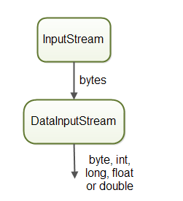
Java DataInputStream class

Slide 3
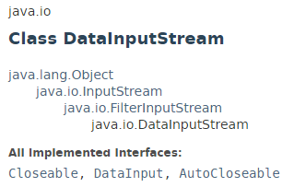

Java DataInputStream class

Slide 4
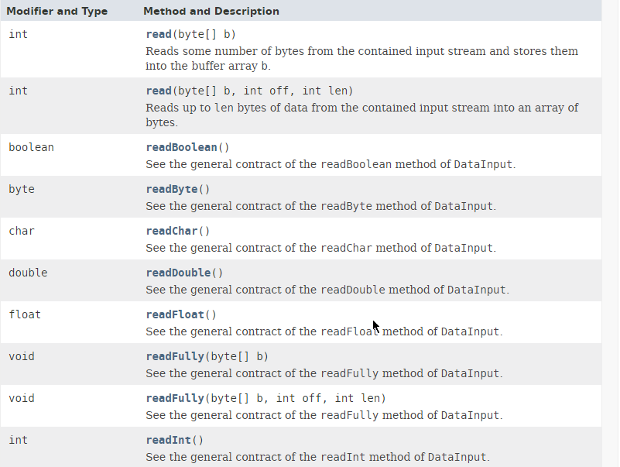
Java DataInputStream class

Slide 5
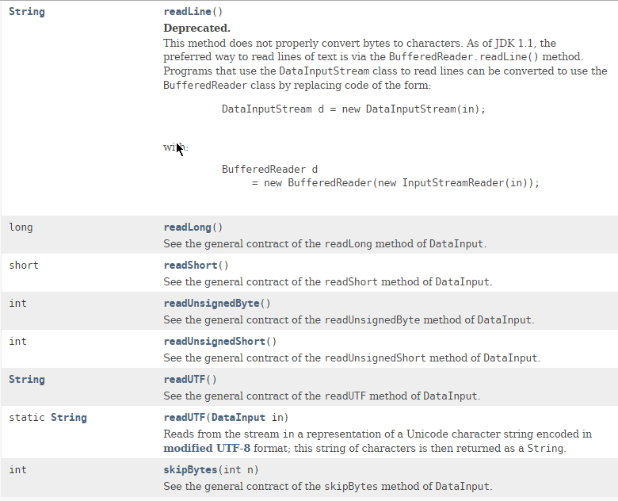
Java DataInputStream class

Slide 6

Java DataInputStream class

Slide 7
Java DataInputStream class
https://docs.oracle.com/javase/8/docs/api/index.html?java/io/DataInputStream.html

